Slide 1
Front end (HTML & css)
Chapters 7 & 8
Lists and Links
Responsive Design

Slide 2
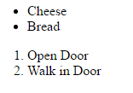

Types of lists
Unordered Lists(Bullets) vs. Ordered Lists (Numbers): Bullets and numbering options can customized in your CSS. Ex: square bullets instead of circles. Letters instead of numbers. <ul> <ol> <li>Cheese</li> <li>Open Door</li> <li>Bread</li> <li>Walk in Door</li> </ul> </ol>
Description Lists: A more intuitive way to list terms and descriptions. <dl> <dt>holus-bolus</dt> <dd>all at once; altogether.</dd> </dl>

Slide 3
Types of links
Use anchor tags <a></a> to create links.
You can link to elements on a page using their ids. Ex: <a href=“#goToTop”>Go to Top</a> will send you to the element with the matching id like <div id=“goToTop”></div>
Absolute links vs. Relative links You can link to a specific page anywhere on the internet by using an absolute link. <a href= http://www.google.com>Google</a> To link to a relative page within your project, you can specify the file itself. <a href=“login.html”>Link</a>
To open a link in a new tab or window, you can add the attribute target=“_blank” to your anchor. <a href=“login.html” target=“_blank”>Link</a>

Slide 4
Making navs out of lists and links
Navigation is commonly composed of an unordered list that contains a series of anchors.
CSS is used to make this look a lot better!
Nested lists can make complex, nested navigation menus!

Slide 5
https://github.com/rconner614/examples

Slide 6
Inside of the admin project, go to the pages folder and open the index.html
Inside the navigation menu, add the following links [nested like they're shown] to the navigation for this website.
(references pages 270 - 273)
Reporting
Financial
Discounts
Refunds
Revenue
General
Type 1
Type 2
Shipping
New Users
Now, make the Type 1 link send you to an element on the page with the id of "timeline-jump". (page 261) Make the Type 2 link send you to google.com, and make this link open in a new tab on the browser. (page 259)

Slide 7
Make the Shipping link send you to login.html, and make this happen in the current tab.
(page 254-255)
A little challenge, make the Discounts link send you to the forms.html page, specifically to the element with the id of "radio-button-jump".
(page 261)

Slide 8
Responsive web design Chapter 8
Media queries and responsive CSS are important to understand and know how to use. However, when approaching a project, you should not be writing all of the media queries for your site by hand. This has already been done! Don't start from scratch!

Slide 9
Media queries
@media(min-width: 768px){
.container {
width: 100%;
}
}
@media(min-width: 1200px){
.container {
width: 80%;
margin: 10px 6px;
}
}

Slide 10
http://getbootstrap.com/css/#grid
Bootstrap has an awesome grid system that helps you build responsive websites in no time. This is a great tool to start a project and will cut down your production time IMMENSELY.
They use a grid of 12 to split up the width of the screen, and help elements move and resize as the screen width changes.
All you have to do is include bootstrap’s CSS and javascript in your project, and the CSS classes are there for you to use!
When testing your responsive website, use your developer tools [F12]. Chrome has a great emulator built into these tools ☺

Slide 11

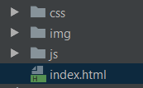
Project structure & best practice
It’s important to keep files organized to maintain assets and find files quickly. It also helps when handing a project off to someone else.
A basic web application or project would have a unique directory for css, images, and javascript files in the root directory. Your index.html or main application file should typically stay in your root directory.

Slide 12
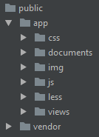

More advanced or resource heavy applications require a more organized structure.
Generally, any files needed to display directly to the user (HTML, JS, CSS, PDFS, JPGS, LESS) are kept in their appropriate directories in a root directory of “public”. This helps clarify what files are “user facing” and accessible by the application.
Inside of public, best practice is to separate your vendor files (BOWER, NPM) from the project’s files. Web application files and directories should be kept in an “app” directory. These are the files you used to build your web application. Vendor files shouldn’t be mixed in here, to prevent any overwriting of vendor code.

Slide 13


LESS (or sass)
Once of the best parts about front end, in my opinion, are precompilers for CSS. At Hondros, we use LESS as our precompiling language. LESS is still CSS, but LESS is more flexible which makes writing CSS faster! And LESS is easier to maintain than CSS. I’ll go over a few things: variables, mixins, and nesting.
Variables
In a project, it’s common to have a couple main colors. These colors are used across your site, and are in your CSS A LOT. LESS allows you to set that color to a variable. Then, you can use that variable in your LESS instead of a hardcoded color code.
Why is this helpful? If you ever need to change that color, you only change it in one place, and when your LESS is compiled into CSS, ever instance of that color will be changed.

Slide 14

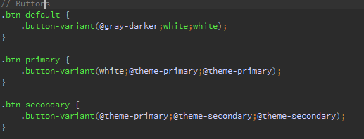
Mixins
Mixins are almost like methods that allow you to create styles over and over using a prebuilt skeleton. You can pass variables to a mixin, and it will create a style that you can add to an element. They look a lot like classes in traditional CSS, only they have a set of parenthesis after the name.
In the example below, the mixin “.button-variant” takes three variables: color, background, border. It then creates a style with a color that is equal to color, background-color that is equal to background, and border-color that is equal to border. From this context, we can assume “.button-variant” is expecting three color inputs.
Now we can use “.button-variant” in our LESS. Below, we’re creating three button classes, and use the mixin for all three!

Slide 15
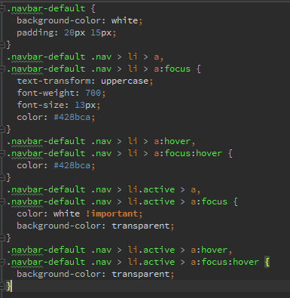
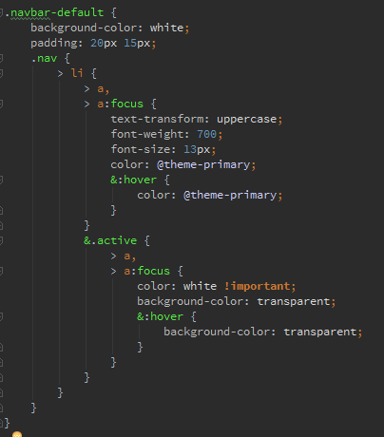
Nested Styles
In CSS, style declarations can get very long. And they can be very redundant.
In LESS, we can nest styles to make styling more readable and maintainable.

Slide 16
http://verekia.com/less-css/dont-read-less-css-tutorial-highly-addictive/ https://www.youtube.com/watch?v=flw2vvl0yvo
The rules for nesting are straightforward. & signs are used to chain classes or pseudo classes in LESS. In the LESS above, the & in front of .active means that the parent element (li) is styled when it is chained with the .active class. In the CSS example, you can see that, once compiled, the LESS is written out to say li.active in place of the & in the LESS.
Nesting is VERY powerful, and can save you a lot of time and frustration when dealing with a complicated or densely styled element, like a nav!
For a great start on learning more about LESS, and how to compile your LESS, I recommend this article and video by Jonathan Verrecchia:

Slide 17
Vendors (BOWER, NPM)
Bower and NPM are package managers. Package manages are used to download plugins and frameworks that have been created and maintained by another party, directly into your project. It can help when you need to put something together quickly. Or if you don’t want to reinvent the wheel! There’s a lot out there, chances are someone has written (and tested!) a package that you can use.
A good example, font awesome! Font awesome maintains a free library of icons, utilized through css. Using bower, you can download the css files and assets from font awesome, and add them to your project. These files, however, will be overwritten if Font Awesome pushes an update. No changes should be made to these files, because they won’t stay! Therefore, vendor files should be kept separately from your application files.

